Slide 1
Probability and Uncertainty

Slide 2
Vocabulary
Event - A collection of outcomes of a procedure.
Simple Event - A single outcome.
Compound Event – A combination of simple event.
Sample Space – All simple events (all possible outcomes).
Example
Procedure | Event | Sample Space
Flip a coin once | H | { H, T}
Flip a coin 3 times | 1 Head & 2 Tails | {HHH, HHT, HTH,HTT, TTT, TTH, THT, THH}

Slide 3
Probability
Def: The likelihood of an event occurring.
Probability : P
Event : A, B, C, …. Etc
P(A) = the probability of event ‘A’ occurring

Slide 4
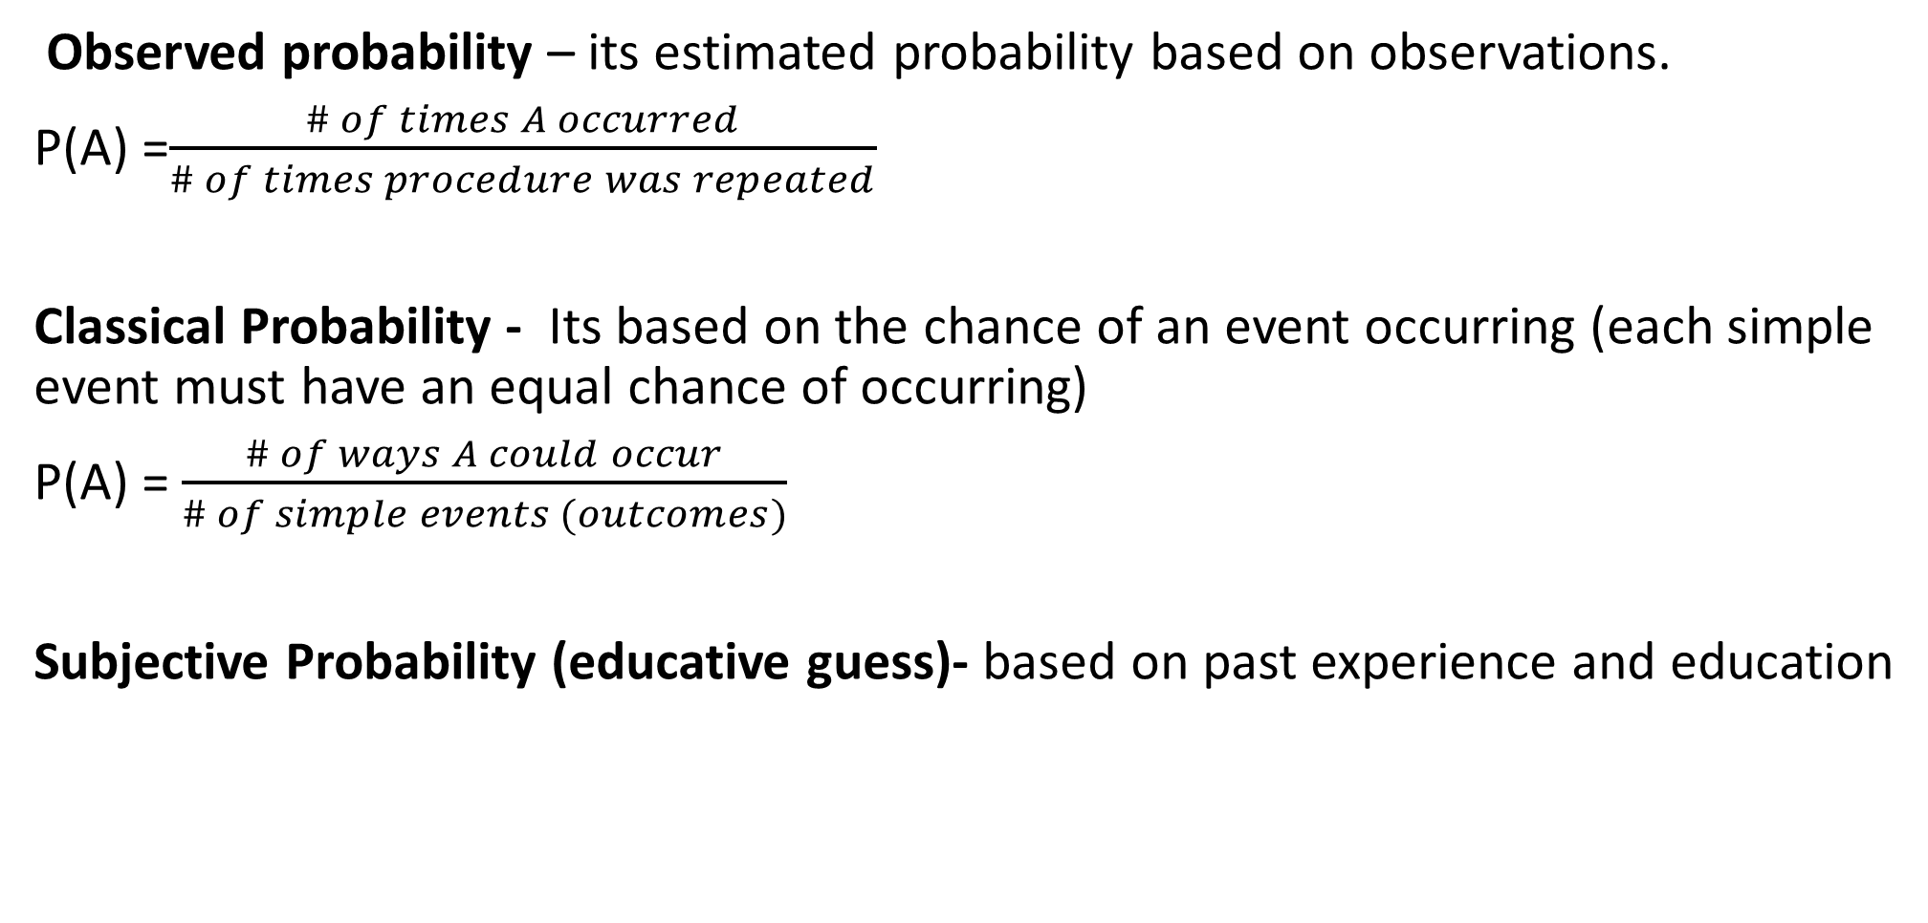
3 types of probability

Slide 5
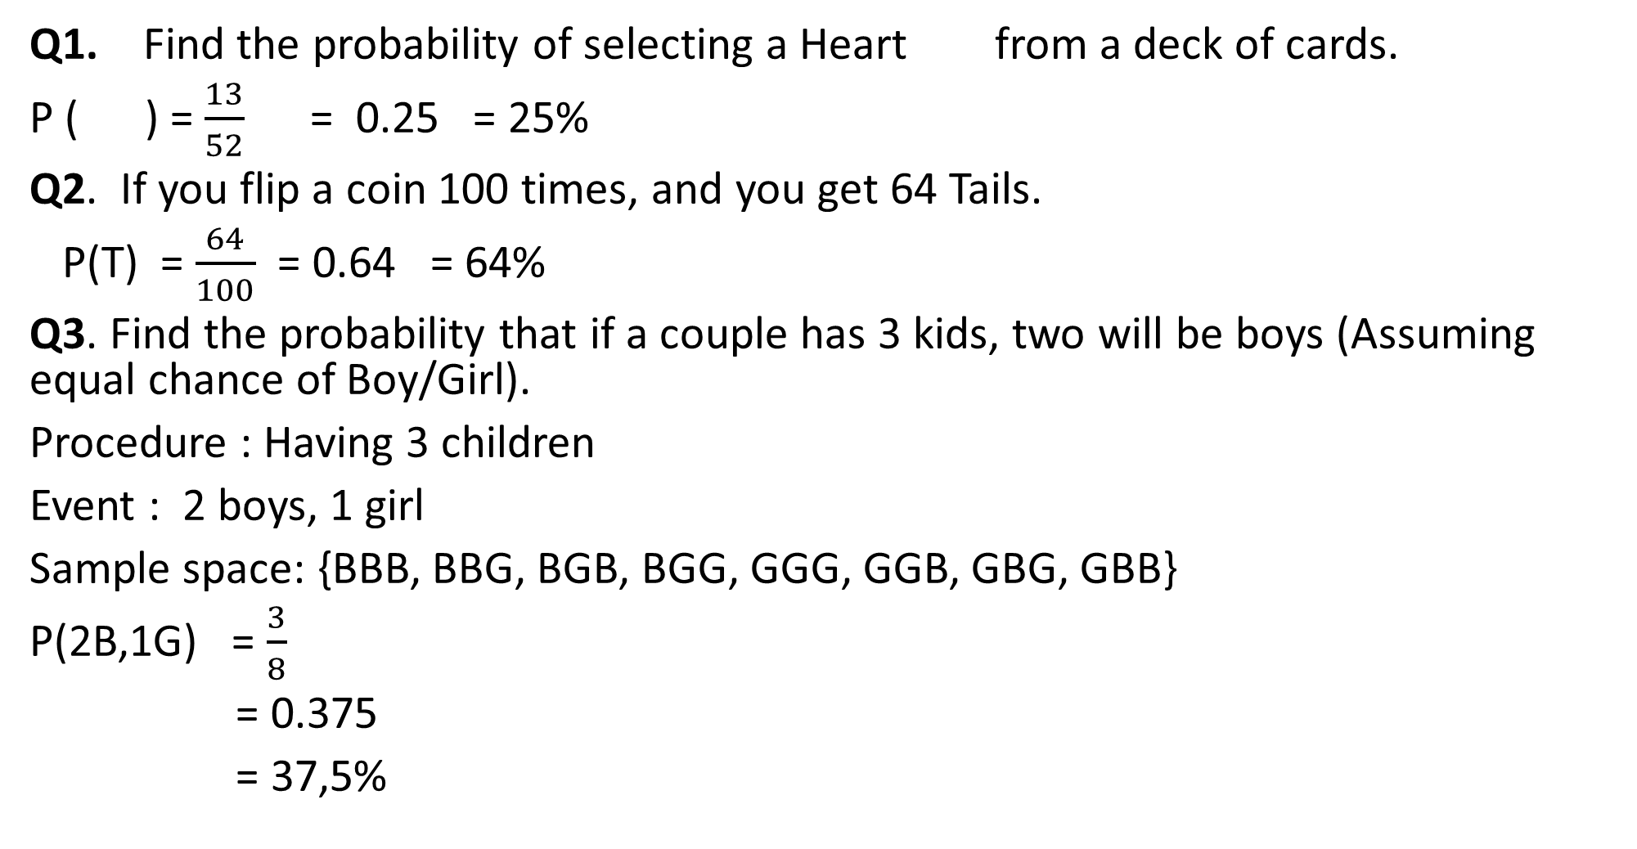


Examples

Slide 6
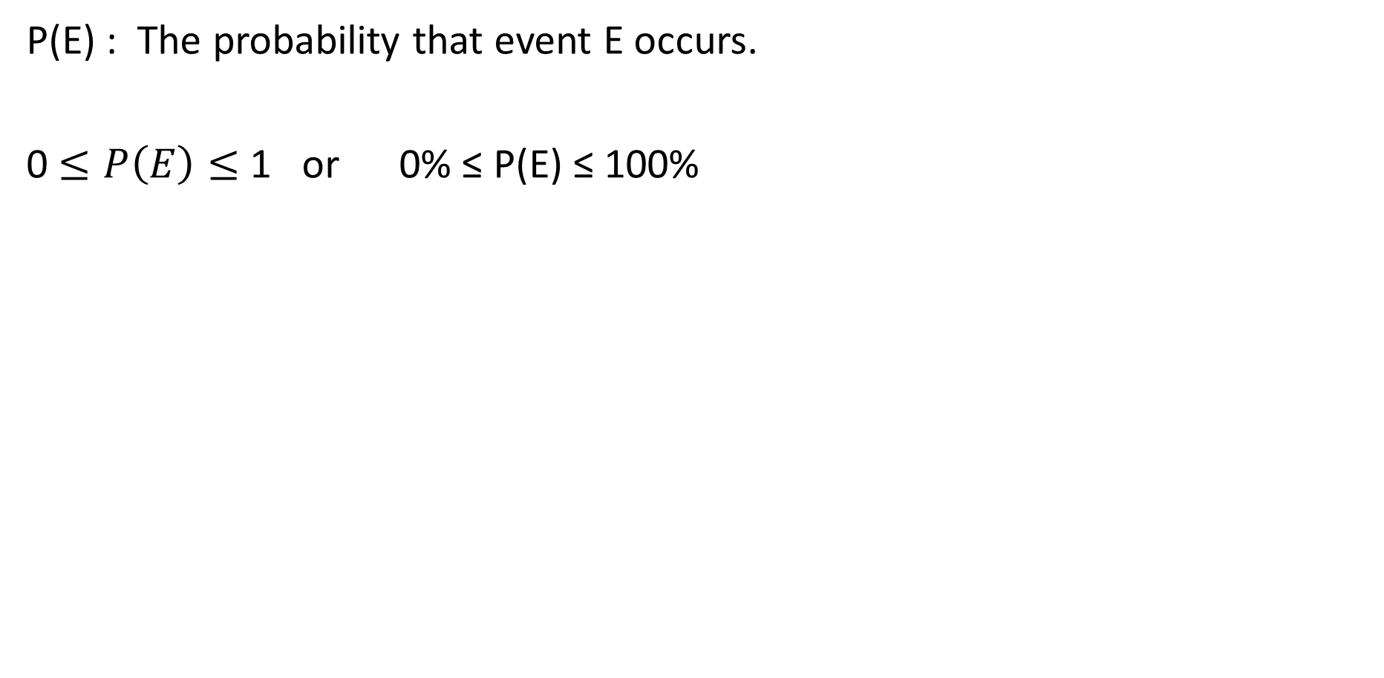
Rules of Probability

Slide 7
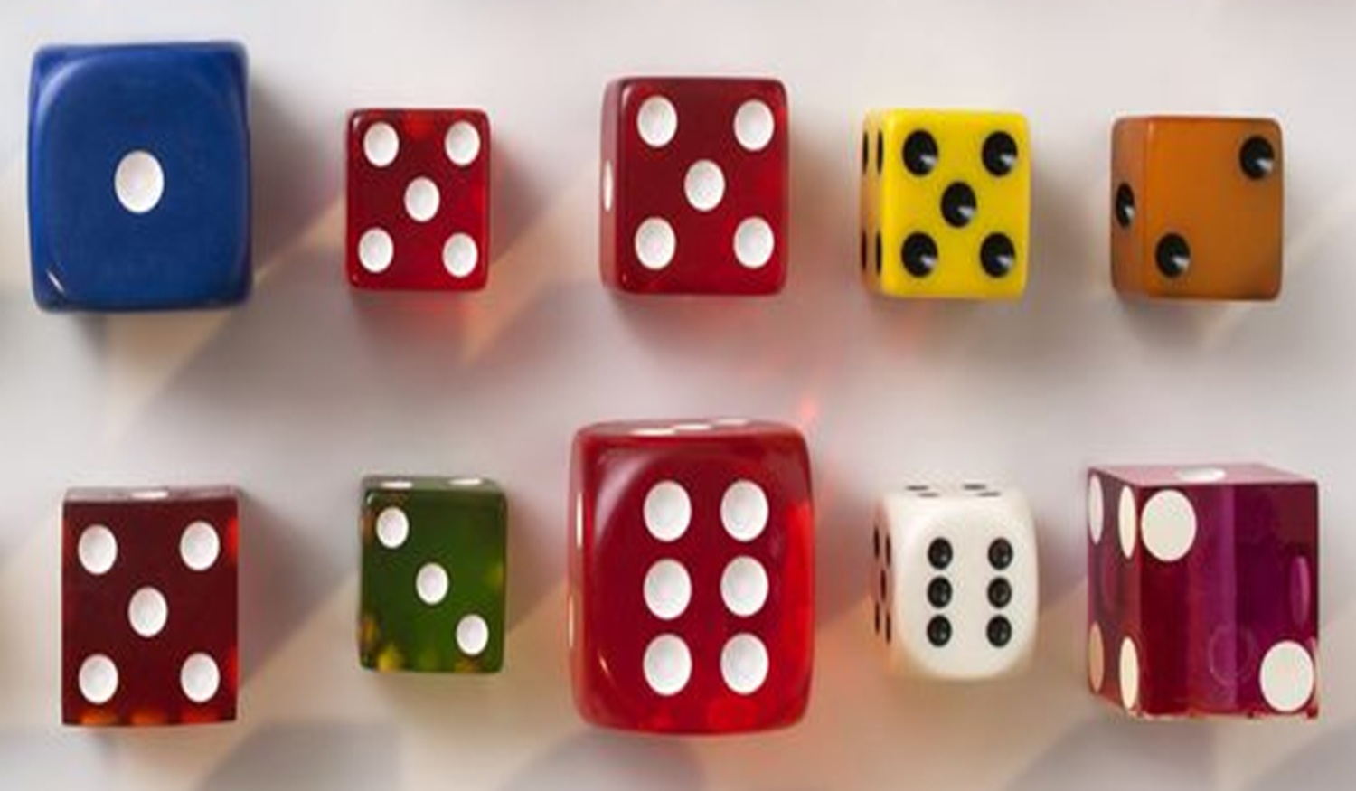
Complementary Events
Events which are mutually exclusive (can’t happen at the same time).
For example: When you roll a 6 sided dice once can you get both
a 2 and a 5 at the same time ? No because they cannot happen
at the same time.

Slide 8
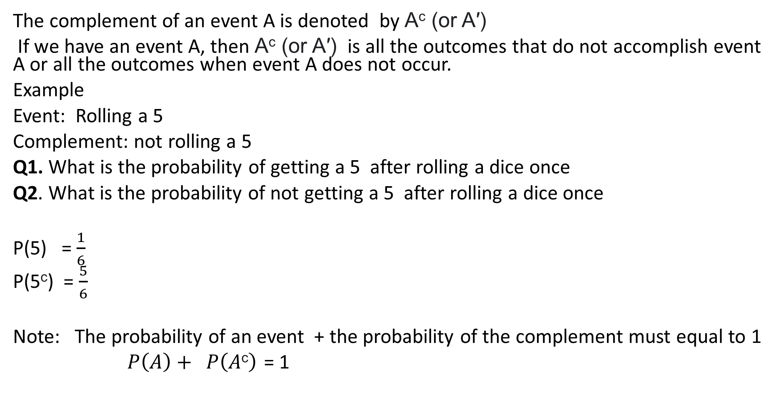
Complement

Slide 9
Exercises on simple probability
When you roll a 6 sided die, which number are you most likely to get?
If you roll a die 600 times, how many sixes would you expect to get?
Use the following to describe the statements bellow: certain, very likely, likely, unlikely, very unlikely, impossible. [Zimbabwean events]
It will snow tomorrow
It will rain tomorrow
The sun will not rise tomorrow
Jesus will come next week
You will win a car in a competition today
You will pass all part one courses at NUST

Slide 10
cont
4. In February 1995 it rained on 18 days. Calculate the probability that it will rain on a day in February. [Relative frequency of rain]
5. A six-sided die and a coin are tossed. List all the possible outcomes.
6. In a class of 30 Computer Science students at NUST, 16 are ladies, 4 wear glasses and 3 are left – handed. A student is chosen at random from the class. What is the probability that this student is:
A lady
A gentleman
Right – handed
Left - handed
Wearing glasses
Not wearing glasses
7. A card is taken at random from a full pack of playing cards with no jockers. What is the probability that the card:
a) Is an ace b) is Black c) is a heart d) has an even number on it

